Slide 1
UNIT 3
PLOTTING USING PYLAB

Slide 2
Plotting using pylab
PyLab is a procedural interface to the Matplotlib object-oriented plotting library. Matplotlib is the whole package; matplotlib.pyplot is a module in Matplotlib; and PyLab is a module that gets installed alongside Matplotlib.
PyLab is a convenience module that bulk imports matplotlib.pyplot (for plotting) and NumPy (for Mathematics and working with arrays) in a single name space. Although many examples use PyLab, it is no longer recommended.

Slide 3
Someone had the idea of combining both the PyPlot and NumPy namespaces into a single one (to avoid having to import two namespaces), the result is PyLab.
Installation
Easiest way to install matplotlib is to use pip. Type following command in terminal:
pip install matplotlib

Slide 4
Basic Plotting
Plotting curves is done with the plot command. It takes a pair of same-length arrays (or sequences) −
from numpy import *
from pylab import *
x = linspace(-3, 3, 30)
y = x**2
plot(x, y)
show()

Slide 5
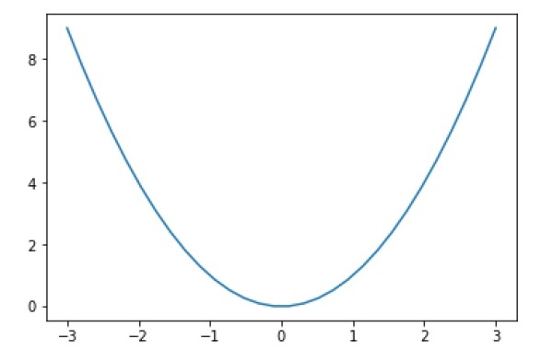
Output :

Slide 6
To plot symbols rather than lines, provide an additional string argument.
Symbols - , –, -., , . , , , o , ^ , v , < , > , s , + , x , D , d , 1 , 2 , 3 , 4 , h , H , p , | , _
colors b, g, r, c, m, y, k, w
Now, consider executing the following code −
from pylab import *
x = linspace(-3, 3, 30)
y = x**2
plot(x, y, 'r.')
show()

Slide 7
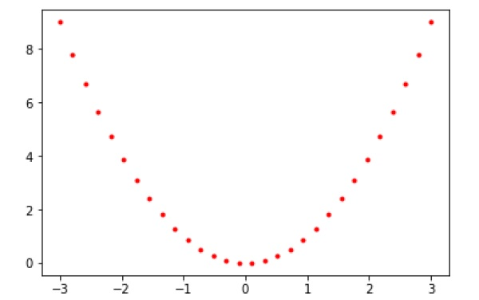

Slide 8
Plots can be overlaid. Just use the multiple plot commands. Use clf() to clear the plot.
from pylab import *
plot(x, sin(x))
plot(x, cos(x), 'r-')
plot(x, -sin(x), 'g--')
show()

Slide 9
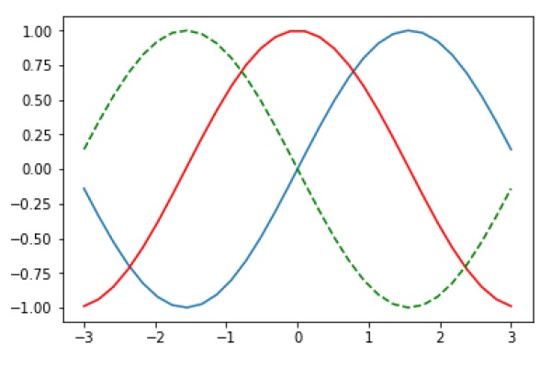

Slide 10
Plotting two or more lines on same plot
import matplotlib.pyplot as plt
# line 1 points
x1 = [1,2,3]
y1 = [2,4,1]
# plotting the line 1 points
plt.plot(x1, y1, label = "line 1")

Slide 11
# line 2 points
x2 = [1,2,3]
y2 = [4,1,3]
# plotting the line 2 points
plt.plot(x2, y2, label = "line 2")

Slide 12
# naming the x axis
plt.xlabel('x - axis')
# naming the y axis
plt.ylabel('y - axis')
# giving a title to my graph
plt.title('Two lines on same graph!')

Slide 13
# show a legend on the plot
plt.legend()
# function to show the plot
plt.show()

Slide 14
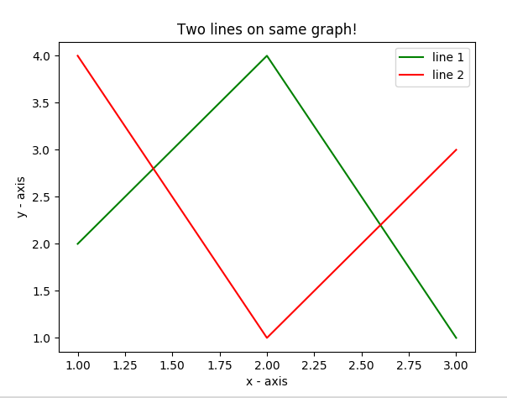

Slide 15
Here, we plot two lines on same graph. We differentiate between them by giving them a name(label) which is passed as an argument of .plot() function.
The small rectangular box giving information about type of line and its color is called legend. We can add a legend to our plot using .legend() function.

Slide 16
Customization of Plots
Here, we discuss some elementary customizations applicable on almost any plot.
import matplotlib.pyplot as plt
# x axis values
x = [1,2,3,4,5,6]
# corresponding y axis values
y = [2,4,1,5,2,6]
# plotting the points
plt.plot(x, y, color='green', linestyle='dashed', linewidth = 3,
marker='o', markerfacecolor='blue', markersize=12)

Slide 17
# setting x and y axis range
plt.ylim(1,8)
plt.xlim(1,8)
# naming the x axis
plt.xlabel('x - axis')
# naming the y axis
plt.ylabel('y - axis')
# giving a title to my graph
plt.title('Some cool customizations!')
# function to show the plot
plt.show()

Slide 18
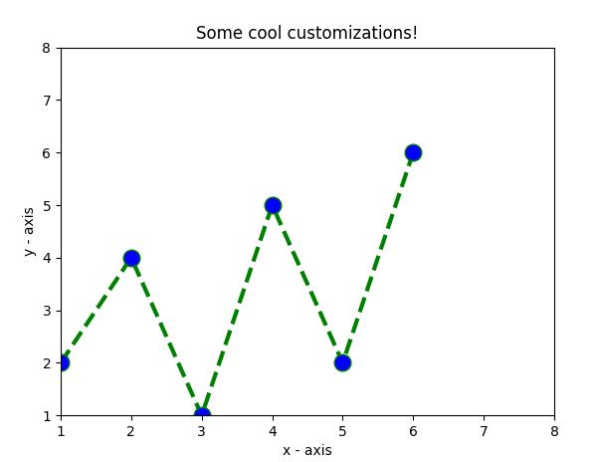

Slide 19
Bar Plot
A bar chart or bar graph is a chart or graph that presents categorical data with rectangular bars with heights or lengths proportional to the values that they represent. The bars can be plotted vertically or horizontally.
A bar graph shows comparisons among discrete categories. One axis of the chart shows the specific categories being compared, and the other axis represents a measured value.Matplotlib API provides the bar() function that can be used in the MATLAB style use as well as object oriented API. The signature of bar() function to be used with axes object is as follows −
ax.bar(x, height, width, bottom, align)

Slide 20
The parameters to the function are −
x | sequence of scalars representing the x coordinates of the bars. align controls if x is the bar center (default) or left edge.
height | scalar or sequence of scalars representing the height(s) of the bars.
width | scalar or array-like, optional. the width(s) of the bars default 0.8
bottom | scalar or array-like, optional. the y coordinate(s) of the bars default None.
align | {‘center’, ‘edge’}, optional, default ‘center’

Slide 21
Following is a simple example of the Matplotlib bar plot. It shows the number of students enrolled for various courses offered at an institute.
import matplotlib.pyplot as plt
fig = plt.figure()
ax = fig.add_axes([0,0,1,1])
langs = ['C', 'C++', 'Java', 'Python', 'PHP']
students = [23,17,35,29,12]
ax.bar(langs,students)
plt.show()

Slide 22
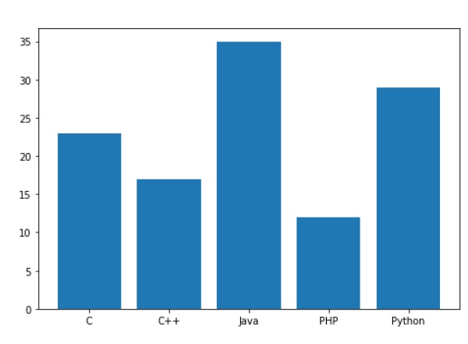

Slide 23
When comparing several quantities and when changing one variable, we might want a bar chart where we have bars of one color for one quantity value.
We can plot multiple bar charts by playing with the thickness and the positions of the bars. The data variable contains three series of four values. The following script will show three bar charts of four bars. The bars will have a thickness of 0.25 units. Each bar chart will be shifted 0.25 units from the previous one. The data object is a multidict containing number of students passed in three branches of an engineering college over the last four years.

Slide 24
import numpy as np
import matplotlib.pyplot as plt
data = [[30, 25, 50, 20],
[40, 23, 51, 17],
[35, 22, 45, 19]]
X = np.arange(4)
fig = plt.figure()
ax = fig.add_axes([0,0,1,1])
ax.bar(X + 0.00, data[0], color = 'b', width = 0.25)
ax.bar(X + 0.25, data[1], color = 'g', width = 0.25)
ax.bar(X + 0.50, data[2], color = 'r', width = 0.25)

Slide 25
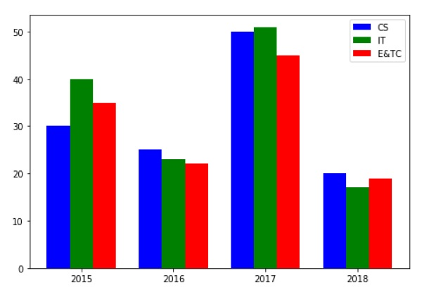

Slide 26
The stacked bar chart stacks bars that represent different groups on top of each other. The height of the resulting bar shows the combined result of the groups.
The optional bottom parameter of the pyplot.bar() function allows you to specify a starting value for a bar. Instead of running from zero to a value, it will go from the bottom to the value. The first call to pyplot.bar() plots the blue bars. The second call to pyplot.bar() plots the red bars, with the bottom of the blue bars being at the top of the red bars.

Slide 27
import numpy as np
import matplotlib.pyplot as plt
N = 5
menMeans = (20, 35, 30, 35, 27)
womenMeans = (25, 32, 34, 20, 25)
ind = np.arange(N) # the x locations for the groups
width = 0.35
fig = plt.figure()
ax = fig.add_axes([0,0,1,1])

Slide 28
ax.bar(ind, menMeans, width, color='r')
ax.bar(ind, womenMeans, width,bottom=menMeans, color='b')
ax.set_ylabel('Scores')
ax.set_title('Scores by group and gender')
ax.set_xticks(ind, ('G1', 'G2', 'G3', 'G4', 'G5'))
ax.set_yticks(np.arange(0, 81, 10))
ax.legend(labels=['Men', 'Women'])
plt.show()

Slide 29
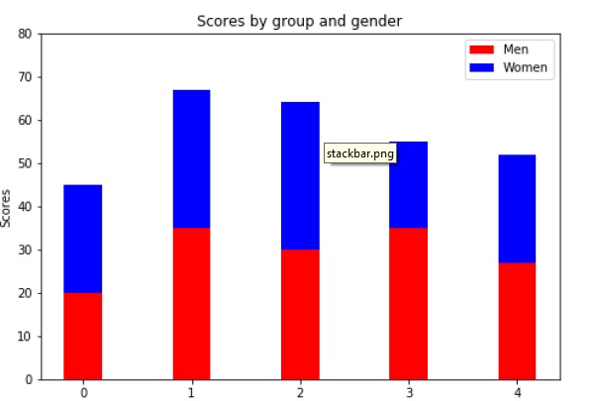

Slide 30
Histogram
A histogram is an accurate representation of the distribution of numerical data. It is an estimate of the probability distribution of a continuous variable. It is a kind of bar graph.
To construct a histogram, follow these steps −
Bin the range of values.
Divide the entire range of values into a series of intervals.
Count how many values fall into each interval.

Slide 31
The bins are usually specified as consecutive, non-overlapping intervals of a variable.
The matplotlib.pyplot.hist() function plots a histogram. It computes and draws the histogram of x.

Slide 32
x | array or sequence of arrays
bins | integer or sequence or ‘auto’, optional
optional parameters
range | The lower and upper range of the bins.
density | If True, the first element of the return tuple will be the counts normalized to form a probability density

Slide 33
cumulative | If True, then a histogram is computed where each bin gives the counts in that bin plus all bins for smaller values.
histtype | The type of histogram to draw. Default is ‘bar’ ‘bar’ is a traditional bar-type histogram. If multiple data are given the bars are arranged side by side. ‘barstacked’ is a bar-type histogram where multiple data are stacked on top of each other. ‘step’ generates a lineplot that is by default unfilled. ‘stepfilled’ generates a lineplot that is by default filled.

Slide 34
Following example plots a histogram of marks obtained by students in a class. Four bins, 0-25, 26-50, 51-75, and 76-100 are defined. The Histogram shows number of students falling in this range.
from matplotlib import pyplot as plt
import numpy as np
fig,ax = plt.subplots(1,1)
a = np.array([22,87,5,43,56,73,55,54,11,20,51,5,79,31,27])
ax.hist(a, bins = [0,25,50,75,100])

Slide 35
ax.set_title("histogram of result")
ax.set_xticks([0,25,50,75,100])
ax.set_xlabel('marks')
ax.set_ylabel('no. of students')
plt.show()

Slide 36
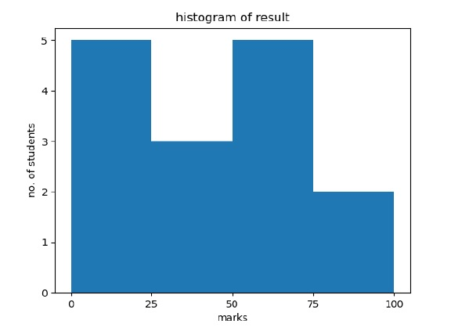

Slide 37
import matplotlib.pyplot as plt
# frequencies
ages = [2,5,70,40,30,45,50,45,43,40,44,60,7,13,57,18,90,77,32,21,20,40]
# setting the ranges and no. of intervals
range = (0, 100)
bins = 10

Slide 38
# plotting a histogram
plt.hist(ages, bins, range, color = 'green', histtype = 'bar', rwidth = 0.8)
# x-axis label
plt.xlabel('age')
# frequency label
plt.ylabel('No. of people')
# plot title
plt.title('My histogram')
# function to show the plot
plt.show()

Slide 39
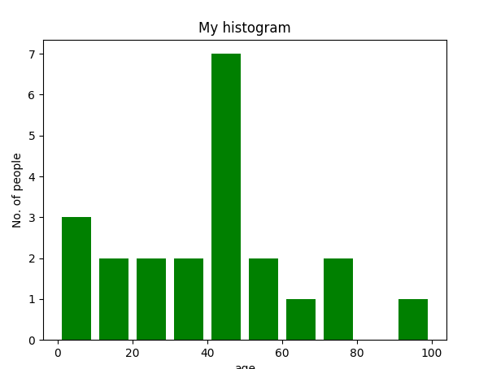

Slide 40
Here, we use plt.hist() function to plot a histogram.
frequencies are passed as the ages list.
Range could be set by defining a tuple containing min and max value.
Next step is to “bin” the range of values—that is, divide the entire range of values into a series of intervals—and then count how many values fall into each interval. Here we have defined bins = 10. So, there are a total of 100/10 = 10 intervals.

Slide 41
Scatter plot
import matplotlib.pyplot as plt
# x-axis values
x = [1,2,3,4,5,6,7,8,9,10]
# y-axis values
y = [2,4,5,7,6,8,9,11,12,12]
# plotting points as a scatter plot
plt.scatter(x, y, label= "stars", color= "green", marker= "*", s=30)

Slide 42
# x-axis label
plt.xlabel('x - axis')
# frequency label
plt.ylabel('y - axis')
# plot title
plt.title('My scatter plot!')
# showing legend
plt.legend()
# function to show the plot
plt.show()

Slide 43
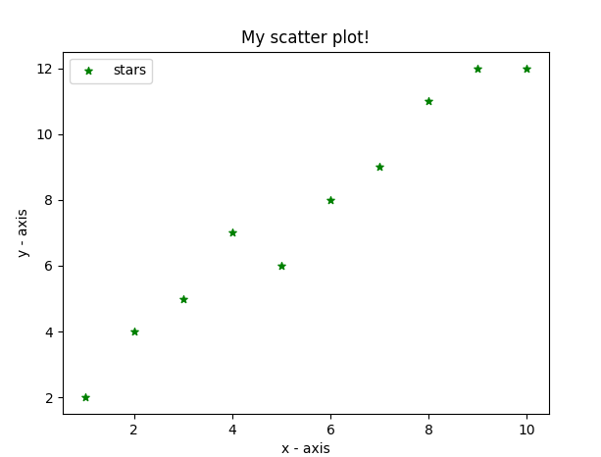

Slide 44
Here, we use plt.scatter() function to plot a scatter plot.
Like a line, we define x and corresponding y – axis values here as well.
marker argument is used to set the character to use as marker. Its size can be defined using s parameter.

Slide 45
Pie Chart
A Pie Chart can only display one series of data. Pie charts show the size of items (called wedge) in one data series, proportional to the sum of the items. The data points in a pie chart are shown as a percentage of the whole pie.
Matplotlib API has a pie() function that generates a pie diagram representing data in an array. The fractional area of each wedge is given by x/sum(x). If sum(x)< 1, then the values of x give the fractional area directly and the array will not be normalized. Theresulting pie will have an empty wedge of size 1 - sum(x).
The pie chart looks best if the figure and axes are square, or the Axes aspect is equal.

Slide 46
Parameters
x | array-like. The wedge sizes.
labels | list. A sequence of strings providing the labels for each wedge.
Colors | A sequence of matplotlibcolorargs through which the pie chart will cycle. If None, will use the colors in the currently active cycle.
Autopct | string, used to label the wedges with their numeric value. The label will be placed inside the wedge. The format string will be fmt%pct.

Slide 47
Following code uses the pie() function to display the pie chart of the list of students enrolled for various computer language courses. The proportionate percentage is displayed inside the respective wedge with the help of autopct parameter which is set to %1.2f%.
from matplotlib import pyplot as plt
import numpy as np
fig = plt.figure()
ax = fig.add_axes([0,0,1,1])
ax.axis('equal')
langs = ['C', 'C++', 'Java', 'Python', 'PHP']
students = [23,17,35,29,12]
ax.pie(students, labels = langs,autopct='%1.2f%%')
plt.show()

Slide 48
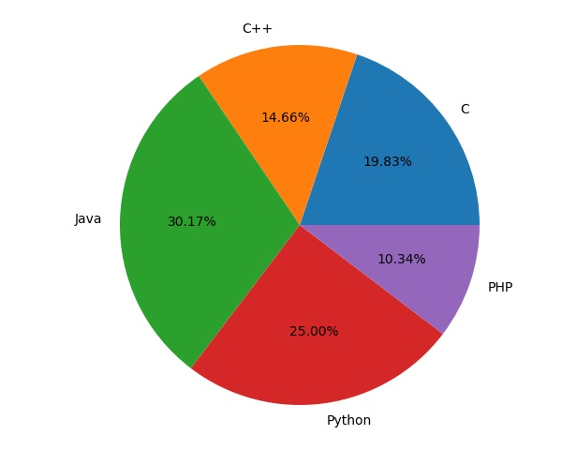

Slide 49
Example :
import matplotlib.pyplot as plt
import numpy as np
y = np.array([35, 25, 25, 15])
plt.pie(y)
plt.show()

Slide 50
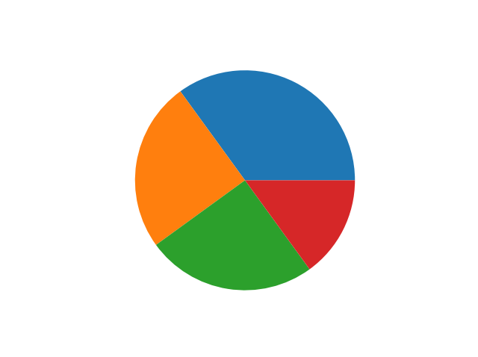

Slide 51
As you can see the pie chart draws one piece (called a wedge) for each value in the array (in this case [35, 25, 25, 15]).
By default the plotting of the first wedge starts from the x-axis and move counterclockwise:

Slide 52
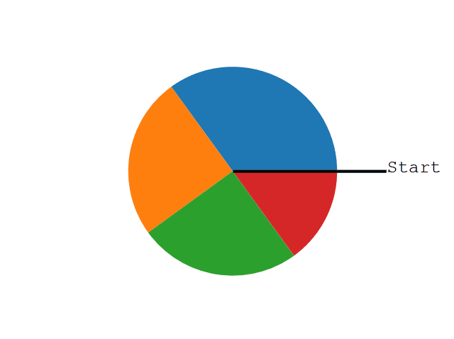
Note: The size of each wedge is determined by comparing the value with all the other values, by using this formula:
The value divided by the sum of all values: x/sum(x)

Slide 53
Labels
Add labels to the pie chart with the label parameter.
The label parameter must be an array with one label for each wedge:
import matplotlib.pyplot as plt
import numpy as np
y = np.array([35, 25, 25, 15])
mylabels = ["Apples", "Bananas", "Cherries", "Dates"]
plt.pie(y, labels = mylabels)
plt.show()

Slide 54
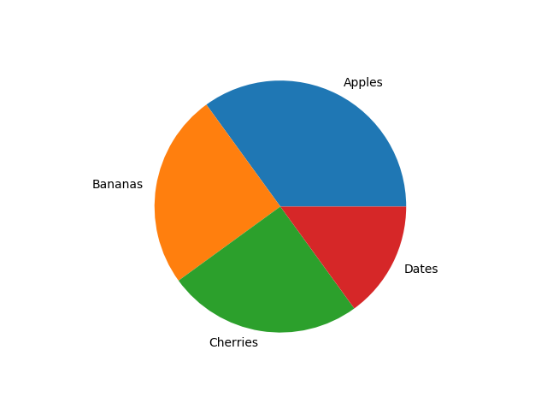

Slide 55
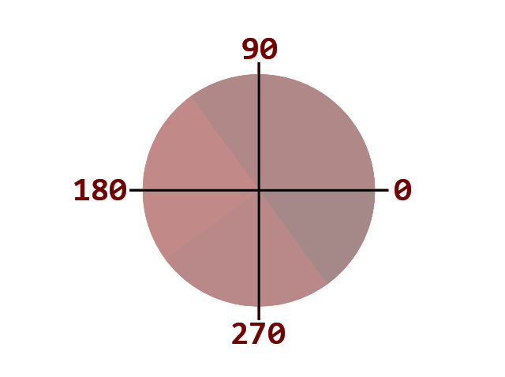
Start Angle
As mentioned the default start angle is at the x-axis, but you can change the start angle by specifying a startangle parameter.
The startangle parameter is defined with an angle in degrees, default angle is 0:

Slide 56
Start the first wedge at 90 degrees:
import matplotlib.pyplot as plt
import numpy as np
y = np.array([35, 25, 25, 15])
mylabels = ["Apples", "Bananas", "Cherries", "Dates"]
plt.pie(y, labels = mylabels, startangle = 90)
plt.show()

Slide 57
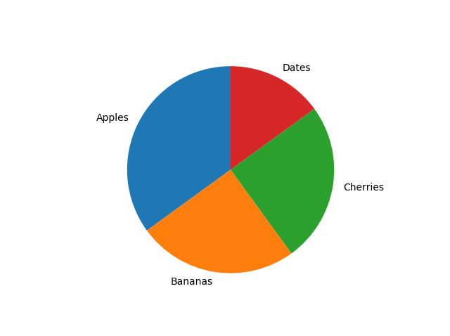

Slide 58
Explode
Maybe you want one of the wedges to stand out? The explode parameter allows you to do that.
The explode parameter, if specified, and not None, must be an array with one value for each wedge.
Each value represents how far from the center each wedge is displayed:

Slide 59
Pull the "Apples" wedge 0.2 from the center of the pie:
import matplotlib.pyplot as plt
import numpy as np
y = np.array([35, 25, 25, 15])
mylabels = ["Apples", "Bananas", "Cherries", "Dates"]
myexplode = [0.2, 0, 0, 0]
plt.pie(y, labels = mylabels, explode = myexplode)
plt.show()

Slide 60
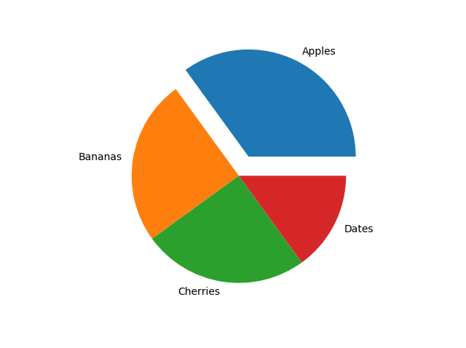

Slide 61
Shadow
Add a shadow to the pie chart by setting the shadows parameter to True:
Add a shadow:
import matplotlib.pyplot as plt
import numpy as np
y = np.array([35, 25, 25, 15])
mylabels = ["Apples", "Bananas", "Cherries", "Dates"]
myexplode = [0.2, 0, 0, 0]
plt.pie(y, labels = mylabels, explode = myexplode, shadow = True)
plt.show()

Slide 62
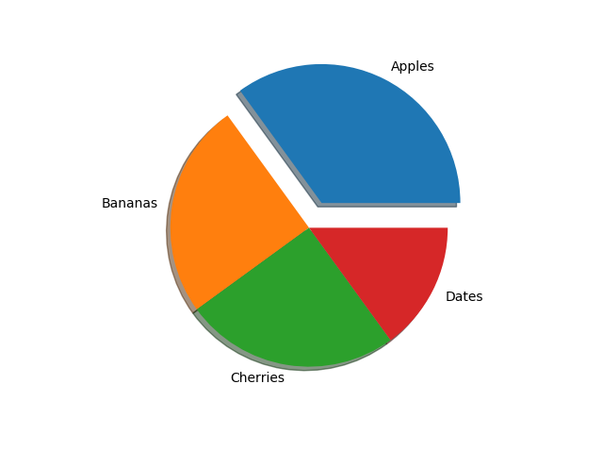

Slide 63
Colors
You can set the color of each wedge with the colors parameter.
The colors parameter, if specified, must be an array with one value for each wedge:
Specify a new color for each wedge:
import matplotlib.pyplot as plt
import numpy as np
y = np.array([35, 25, 25, 15])
mylabels = ["Apples", "Bananas", "Cherries", "Dates"]
mycolors = ["black", "hotpink", "b", "#4CAF50"]
plt.pie(y, labels = mylabels, colors = mycolors)
plt.show()

Slide 64
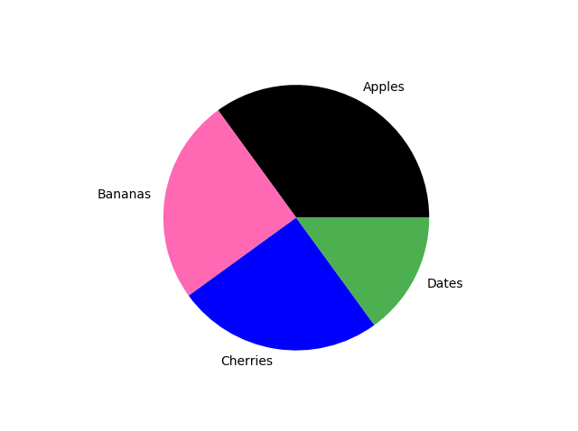

Slide 65
You can use Hexadecimal color values, any of the 140 supported color names, or one of these shortcuts:
'r' - Red
'g' - Green
'b' - Blue
'c' - Cyan
'm' - Magenta
'y' - Yellow
'k' - Black
'w' - White

Slide 66
Legend
To add a list of explanation for each wedge, use the legend() function:
Add a legend:
import matplotlib.pyplot as plt
import numpy as np
y = np.array([35, 25, 25, 15])
mylabels = ["Apples", "Bananas", "Cherries", "Dates"]
plt.pie(y, labels = mylabels)
plt.legend()
plt.show()

Slide 67
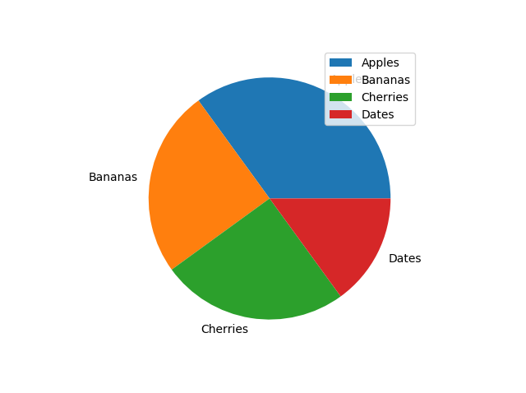

Slide 68
Legend With Header
To add a header to the legend, add the title parameter to the legend function.
Add a legend with a header:
import matplotlib.pyplot as plt
import numpy as np
y = np.array([35, 25, 25, 15])
mylabels = ["Apples", "Bananas", "Cherries", "Dates"]
plt.pie(y, labels = mylabels)
plt.legend(title = "Four Fruits:")
plt.show()

Slide 69
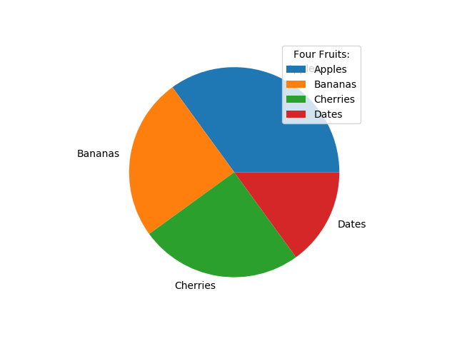

Slide 70
mortgage
What is a Mortgage?
A mortgage is a loan – provided by a mortgage lender or a bank – that enables an individual to purchase a home or property. While it’s possible to take out loans to cover the entire cost of a home, it’s more common to secure a loan for about 80% of the home’s value.

Slide 71
Types of Mortgages
The two most common types of mortgages are fixed-rate and adjustable-rate (also known as variable rate) mortgages.
Fixed-Rate Mortgages
Fixed-rate mortgages provide borrowers with an established interest rate over a set term of typically 15, 20, or 30 years. With a fixed interest rate, the shorter the term over which the borrower pays, the higher the monthly payment. Conversely, the longer the borrower takes to pay, the smaller the monthly repayment amount. However, the longer it takes to repay the loan, the more the borrower ultimately pays in interest charges.

Slide 72
The greatest advantage of a fixed-rate mortgage is that the borrower can count on their monthly mortgage payments being the same every month throughout the life of their mortgage, making it easier to set household budgets and avoid any unexpected additional charges from one month to the next. Even if market rates increase significantly, the borrower doesn’t have to make higher monthly payments.

Slide 73
Adjustable-Rate Mortgages
Adjustable-rate mortgages (ARMs) come with interest rates that can – and usually, do – change over the life of the loan. Increases in market rates and other factors cause interest rates to fluctuate, which changes the amount of interest the borrower must pay, and, therefore, changes the total monthly payment due. With adjustable rate mortgages, the interest rate is set to be reviewed and adjusted at specific times. For example, the rate may be adjusted once a year or once every six months.

Slide 74
Mortgage Payments
Mortgage payments usually occur on a monthly basis and consist of four main parts:
1. Principal
The principal is the total amount of the loan given. For example, if an individual takes out a $250,000 mortgage to purchase a home, then the principal loan amount is $250,000. Lenders typically like to see a 20% down payment on the purchase of a home. So, if the $250,000 mortgage represents 80% of the home’s appraised value, then the homebuyers would be making a down payment of $62,500, and the total purchase price of the home would be $312,500.

Slide 75
2. Interest
The interest is the monthly percentage added to each mortgage payment. Lenders and banks don’t simply loan individuals money without expecting to get something in return. Interest is the money a lender or bank earns or charges on the money they loaned to homebuyers.

Slide 76
3. Taxes
In most cases, mortgage payments will include the property tax the individual must pay as a homeowner. The municipal taxes are calculated based on the value of the home.

Slide 77
4. Insurance
Mortgages also include homeowner’s insurance, which is required by lenders to cover damage to the home (which acts as collateral), as well as the property inside of it. It also covers specific mortgage insurance, which is generally required if an individual makes a down payment that is less than 20% of the home’s cost. That insurance is designed to protect the lender or bank if the borrower defaults on his or her loan.

Slide 78
Dynamic Programming
is repeating the things for which you already have the answer, a good thing ? A programmer would disagree. That's what Dynamic Programming is about. To always remember answers to the sub-problems you've already solved.

Slide 79
Dynamic programming is a problem-solving technique for resolving complex problems by recursively breaking them up into sub-problems, which are then each solved individually. Dynamic programming optimizes recursive programming and saves us the time of re-computing inputs later.

Slide 80
The idea is very simple, If you have solved a problem with the given input, then save the result for future reference, so as to avoid solving the same problem again.. shortly 'Remember your Past' :) . If the given problem can be broken up into smaller sub-problems and these smaller subproblems are in turn divided in to still-smaller ones, and in this process, if you observe some over-lapping subproblems, then it’s a big hint for DP

Slide 81
There are two ways of doing this :
1.) Top-Down : Start solving the given problem by breaking it down. If you see that the problem has been solved already, then just return the saved answer. If it has not been solved, solve it and save the answer. This is usually easy to think of and very intuitive. This is referred to as Memoization.

Slide 82
2.) Bottom-Up : Analyze the problem and see the order in which the sub-problems are solved and start solving from the trivial subproblem, up towards the given problem. In this process, it is guaranteed that the subproblems are solved before solving the problem. This is referred to as Dynamic Programming.

Slide 83
Real-world Dynamic Programing
Unlike computers, memory-based processes like dynamic programming are intuitive to humans. Consider this real-world example:
Imagine you want to go to a new grocery store a few streets away, but you don’t know how to get there. To solve the sub-problem of the route to the store, you look up directions on your smartphone’s map and then make your way there.

Slide 84
If you thought in a recursive fashion, each time you wanted to go to the store, you’d have to take the time to look up the directions again.
Instead, we naturally think dynamically, remembering the directions to the store from when we first looked them up, and as a result we don’t need to spend the time looking them up when we go in the future.
This is in essence how dynamic programming functions in programs as well.

Slide 85
Program for Fibonacci numbers
The Fibonacci numbers are the numbers in the following integer sequence.
0, 1, 1, 2, 3, 5, 8, 13, 21, 34, 55, 89, 144, ……..
In mathematical terms, the sequence Fn of Fibonacci numbers is defined by the recurrence relation

Slide 86
Fn = Fn-1 + Fn-2
with seed values
F0 = 0 and F1 = 1.
Note : It is used to initialize the random number generator.
The random number generator needs a number to start with (a seed value), to be able to generate a random number.

Slide 87
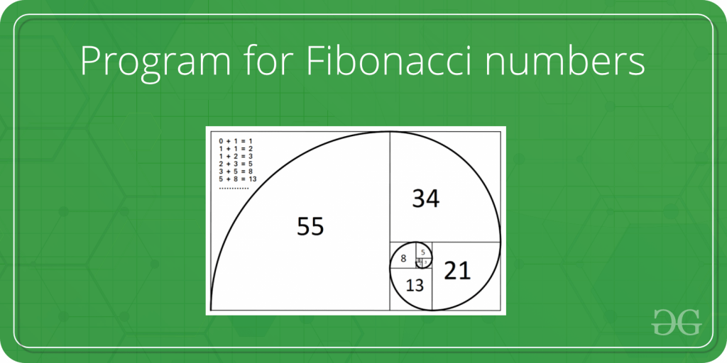

Slide 88
Given a number n, print n-th Fibonacci Number.
Examples:
Input : n = 2
Output : 1
Input : n = 9
Output : 34

Slide 89
def fib(n):
if n == 0:
return 0
if n == 1:
return 1
return fib(n - 1) + fib(n - 2)

Slide 90
def all_fib(n):
fibs = []
for i in range(n):
fibs.append(fib(i))
return fibs
print(all_fib(10))

Slide 91
Fibonacci sequence revisited :Let’s see what it looks like when applying dynamic programming.
def all_fib_dp(n):
fibs = []
for i in range(n):
if i < 2:
fibs.append(i)
else:
fibs.append(fibs[i - 2] + fibs[i - 1])
return fibs

Slide 92
This time we’re saving the result at each iteration and computing new numbers as a sum of the previously saved results. Let’s see what this does to the performance of the function.
print(all_fib_dp(40))

Slide 93
0/1 Knapsack algorithm
Knapsack Problem-
You are given the following-
A knapsack (kind of shoulder bag) with limited weight capacity.
Few items each having some weight and value.

Slide 94
The problem states-
Which items should be placed into the knapsack such that-
The value or profit obtained by putting the items into the knapsack is maximum.
And the weight limit of the knapsack does not exceed.

Slide 95
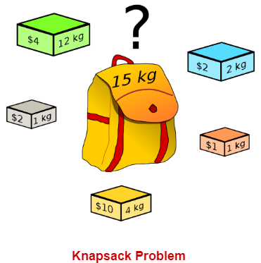

Slide 96
0/1 Knapsack Problem Using Dynamic Programming-
Consider-
Knapsack weight capacity = w
Number of items each having some weight and value = n

Slide 97
0/1 knapsack problem is solved using dynamic programming in the following steps-
Step-01:
Draw a table say ‘T’ with (n+1) number of rows and (w+1) number of columns.
Fill all the boxes of 0th row and 0th column with zeroes as shown-

Slide 98
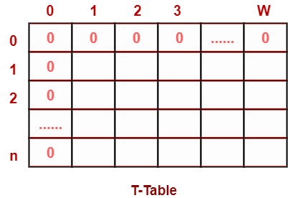

Slide 99
Step-02:
Start filling the table row wise top to bottom from left to right.
Use the following formula-
T (i , j) = max { T ( i-1 , j ) , valuei + T( i-1 , j – weighti ) }
Here, T(i , j) = maximum value of the selected items if we can take items 1 to i and have weight restrictions of j.
This step leads to completely filling the table.
Then, value of the last box represents the maximum possible value that can be put into the knapsack.

Slide 100
This step leads to completely filling the table.
Then, value of the last box represents the maximum possible value that can be put into the knapsack.

Slide 101
Step-03:
To identify the items that must be put into the knapsack to obtain that maximum profit,
Consider the last column of the table.
Start scanning the entries from bottom to top.
On encountering an entry whose value is not same as the value stored in the entry immediately above it, mark the row label of that entry.
After all the entries are scanned, the marked labels represent the items that must be put into the knapsack.

Slide 102
Time Complexity-
Each entry of the table requires constant time θ(1) for its computation.
It takes θ(nw) time to fill (n+1)(w+1) table entries.
It takes θ(n) time for tracing the solution since tracing process traces the n rows.
Thus, overall θ(nw) time is taken to solve 0/1 knapsack problem using dynamic programming.

Slide 103
PRACTICE PROBLEM BASED ON 0/1 KNAPSACK PROBLEM-
Problem-For the given set of items and knapsack capacity = 5 kg, find the optimal solution for the 0/1 knapsack problem making use of dynamic programming approach.
Item | Weight | Value
1 | 2 | 3
2 | 3 | 4
3 | 4 | 5
4 | 5 | 6

Slide 104
Solution-
Given-
Knapsack capacity (w) = 5 kg
Number of items (n) = 4
Step-01:
Draw a table say ‘T’ with (n+1) = 4 + 1 = 5 number of rows and (w+1) = 5 + 1 = 6 number of columns.
Fill all the boxes of 0th row and 0th column with 0.

Slide 105
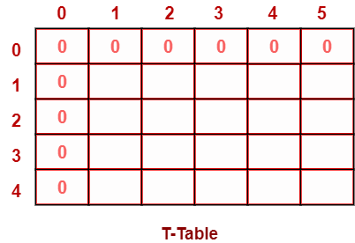

Slide 106
Step-02:
Start filling the table row wise top to bottom from left to right using the formula-
T (i , j) = max { T ( i-1 , j ) , valuei + T( i-1 , j – weighti ) }

Slide 107
Finding T(1,1)-
We have,
i = 1
j = 1
(value)i = (value)1 = 3
(weight)i = (weight)1 = 2

Slide 108
Substituting the values, we get-
T(1,1) = max { T(1-1 , 1) , 3 + T(1-1 , 1-2) }
T(1,1) = max { T(0,1) , 3 + T(0,-1) }
T(1,1) = T(0,1) { Ignore T(0,-1) }
T(1,1) = 0

Slide 109
Finding T(1,2)-
We have,
i = 1
j = 2
(value)i = (value)1 = 3
(weight)i = (weight)1 = 2

Slide 110
Substituting the values, we get-
T(1,2) = max { T(1-1 , 2) , 3 + T(1-1 , 2-2) }
T(1,2) = max { T(0,2) , 3 + T(0,0) }
T(1,2) = max {0 , 3+0}
T(1,2) = 3

Slide 111
Finding T(1,3)-
We have,
i = 1
j = 3
(value)i = (value)1 = 3
(weight)i = (weight)1 = 2

Slide 112
Substituting the values, we get-
T(1,3) = max { T(1-1 , 3) , 3 + T(1-1 , 3-2) }
T(1,3) = max { T(0,3) , 3 + T(0,1) }
T(1,3) = max {0 , 3+0}
T(1,3) = 3

Slide 113
Finding T(1,4)-
We have,
i = 1
j = 4
(value)i = (value)1 = 3
(weight)i = (weight)1 = 2

Slide 114
Substituting the values, we get-
T(1,4) = max { T(1-1 , 4) , 3 + T(1-1 , 4-2) }
T(1,4) = max { T(0,4) , 3 + T(0,2) }
T(1,4) = max {0 , 3+0}
T(1,4) = 3

Slide 115
Finding T(1,5)-
We have,
i = 1
j = 5
(value)i = (value)1 = 3
(weight)i = (weight)1 = 2

Slide 116
Substituting the values, we get-
T(1,5) = max { T(1-1 , 5) , 3 + T(1-1 , 5-2) }
T(1,5) = max { T(0,5) , 3 + T(0,3) }
T(1,5) = max {0 , 3+0}
T(1,5) = 3

Slide 117
Finding T(2,1)-
We have,
i = 2
j = 1
(value)i = (value)2 = 4
(weight)i = (weight)2 = 3

Slide 118
Substituting the values, we get-
T(2,1) = max { T(2-1 , 1) , 4 + T(2-1 , 1-3) }
T(2,1) = max { T(1,1) , 4 + T(1,-2) }
T(2,1) = T(1,1) { Ignore T(1,-2) }
T(2,1) = 0

Slide 119
Finding T(2,2)-
We have,
i = 2
j = 2
(value)i = (value)2 = 4
(weight)i = (weight)2 = 3

Slide 120
Substituting the values, we get-
T(2,2) = max { T(2-1 , 2) , 4 + T(2-1 , 2-3) }
T(2,2) = max { T(1,2) , 4 + T(1,-1) }
T(2,2) = T(1,2) { Ignore T(1,-1) }
T(2,2) = 3

Slide 121
Finding T(2,3)-
We have,
i = 2
j = 3
(value)i = (value)2 = 4
(weight)i = (weight)2 = 3

Slide 122
Substituting the values, we get-
T(2,3) = max { T(2-1 , 3) , 4 + T(2-1 , 3-3) }
T(2,3) = max { T(1,3) , 4 + T(1,0) }
T(2,3) = max { 3 , 4+0 }
T(2,3) = 4

Slide 123
Finding T(2,4)-
We have,
i = 2
j = 4
(value)i = (value)2 = 4
(weight)i = (weight)2 = 3

Slide 124
Substituting the values, we get-
T(2,4) = max { T(2-1 , 4) , 4 + T(2-1 , 4-3) }
T(2,4) = max { T(1,4) , 4 + T(1,1) }
T(2,4) = max { 3 , 4+0 }
T(2,4) = 4

Slide 125
Finding T(2,5)-
We have,
i = 2
j = 5
(value)i = (value)2 = 4
(weight)i = (weight)2 = 3

Slide 126
Substituting the values, we get-
T(2,5) = max { T(2-1 , 5) , 4 + T(2-1 , 5-3) }
T(2,5) = max { T(1,5) , 4 + T(1,2) }
T(2,5) = max { 3 , 4+3 }
T(2,5) = 7

Slide 127
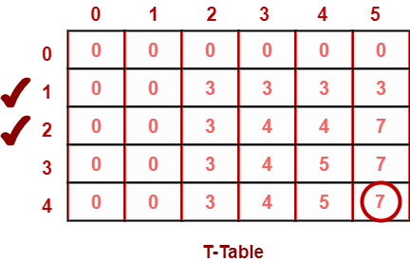
Similarly, compute all the entries.
After all the entries are computed and filled in the table, we get the following table-

Slide 128
The last entry represents the maximum possible value that can be put into the knapsack.
So, maximum possible value that can be put into the knapsack = 7.

Slide 129
Identifying Items To Be Put Into Knapsack-
Following Step-04,
We mark the rows labelled “1” and “2”.
Thus, items that must be put into the knapsack to obtain the maximum value 7 are-
Item-1 and Item-2

Slide 130
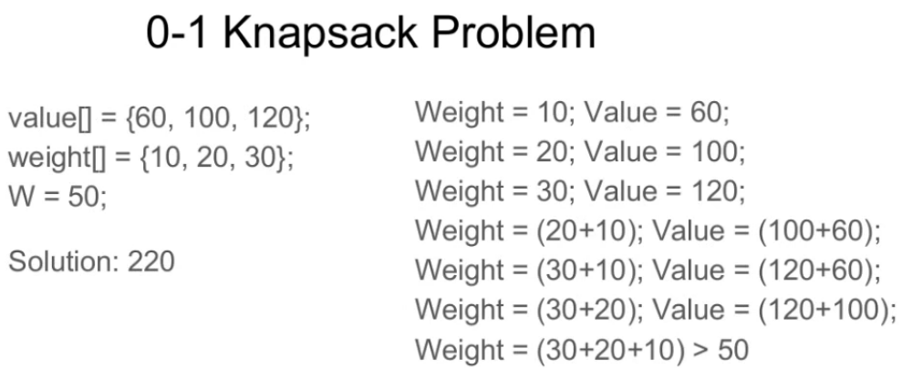

Slide 131
# A naive recursive implementation
# of 0-1 Knapsack Problem
# Returns the maximum value that
# can be put in a knapsack of
# capacity W

Slide 132
def knapSack(W, wt, val, n):
# Base Case
if n == 0 or W == 0:
return 0

Slide 133
# If weight of the nth item is
# more than Knapsack of capacity W,
# then this item cannot be included
# in the optimal solution
if (wt[n-1] > W):
return knapSack(W, wt, val, n-1)

Slide 134
# return the maximum of two cases:
# (1) nth item included
# (2) not included
else:
return max(
val[n-1] + knapSack(
W-wt[n-1], wt, val, n-1),
knapSack(W, wt, val, n-1))
# end of function knapSack

Slide 135
#Driver Code
val = [60, 100, 120]
wt = [10, 20, 30]
W = 50
n = len(val)
print knapSack(W, wt, val, n)
Output :
220

Slide 136
Dynamic programming and divide and conquer
In divide and conquer approach, the problem in hand, is divided into smaller sub-problems and then each problem is solved independently. When we keep on dividing the subproblems into even smaller sub-problems, we may eventually reach a stage where no more division is possible. Those "atomic" smallest possible sub-problem (fractions) are solved. The solution of all sub-problems is finally merged in order to obtain the solution of an original problem.

Slide 137
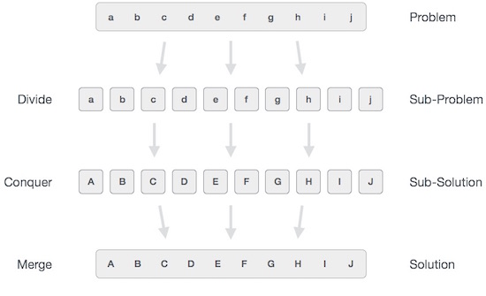

Slide 138
Broadly, we can understand divide-and-conquer approach in a three-step process.
Divide/Break
This step involves breaking the problem into smaller sub-problems. Sub-problems should represent a part of the original problem. This step generally takes a recursive approach to divide the problem until no sub-problem is further divisible. At this stage, sub-problems become atomic in nature but still represent some part of the actual problem.

Slide 139
Conquer/Solve
This step receives a lot of smaller sub-problems to be solved. Generally, at this level, the problems are considered 'solved' on their own.
Merge/Combine
When the smaller sub-problems are solved, this stage recursively combines them until they formulate a solution of the original problem. This algorithmic approach works recursively and conquer & merge steps works so close that they appear as one.

Slide 140
The following program is an example of divide-and-conquer programming approach where the binary search is implemented using python.
Binary Search implementation
In binary search we take a sorted list of elements and start looking for an element at the middle of the list. If the search value matches with the middle value in the list we complete the search. Otherwise we eleminate half of the list of elements by choosing whether to procees with the right or left half of the list depending on the value of the item searched.

Slide 141
This is possible as the list is sorted and it is much quicker than linear search. Here we divide the given list and conquer by choosing the proper half of the list. We repeat this approcah till we find the element or conclude about it's absence in the list.

Slide 142
def bsearch(list, val):
list_size = len(list) - 1
idx0 = 0
idxn = list_size

Slide 143
# Find the middle most value
while idx0 <= idxn:
midval = (idx0 + idxn)// 2
if list[midval] == val:
return midval

Slide 144
# Compare the value the middle most value
if val > list[midval]:
idx0 = midval + 1
else:
idxn = midval - 1
if idx0 > idxn:
return None

Slide 145
# Initialize the sorted list
list = [2,7,19,34,53,72]
# Print the search result
print(bsearch(list,72))
print(bsearch(list,11))

Slide 146
When the above code is executed, it produces the following result:
5
None

Slide 147
Unit - 3 completed

